Slide 1

ADVENTURES WITH THE WVARA TOWER TRAILER
DEAN WOOD, N6DE
NOVEMBER 17, 2010

Slide 2
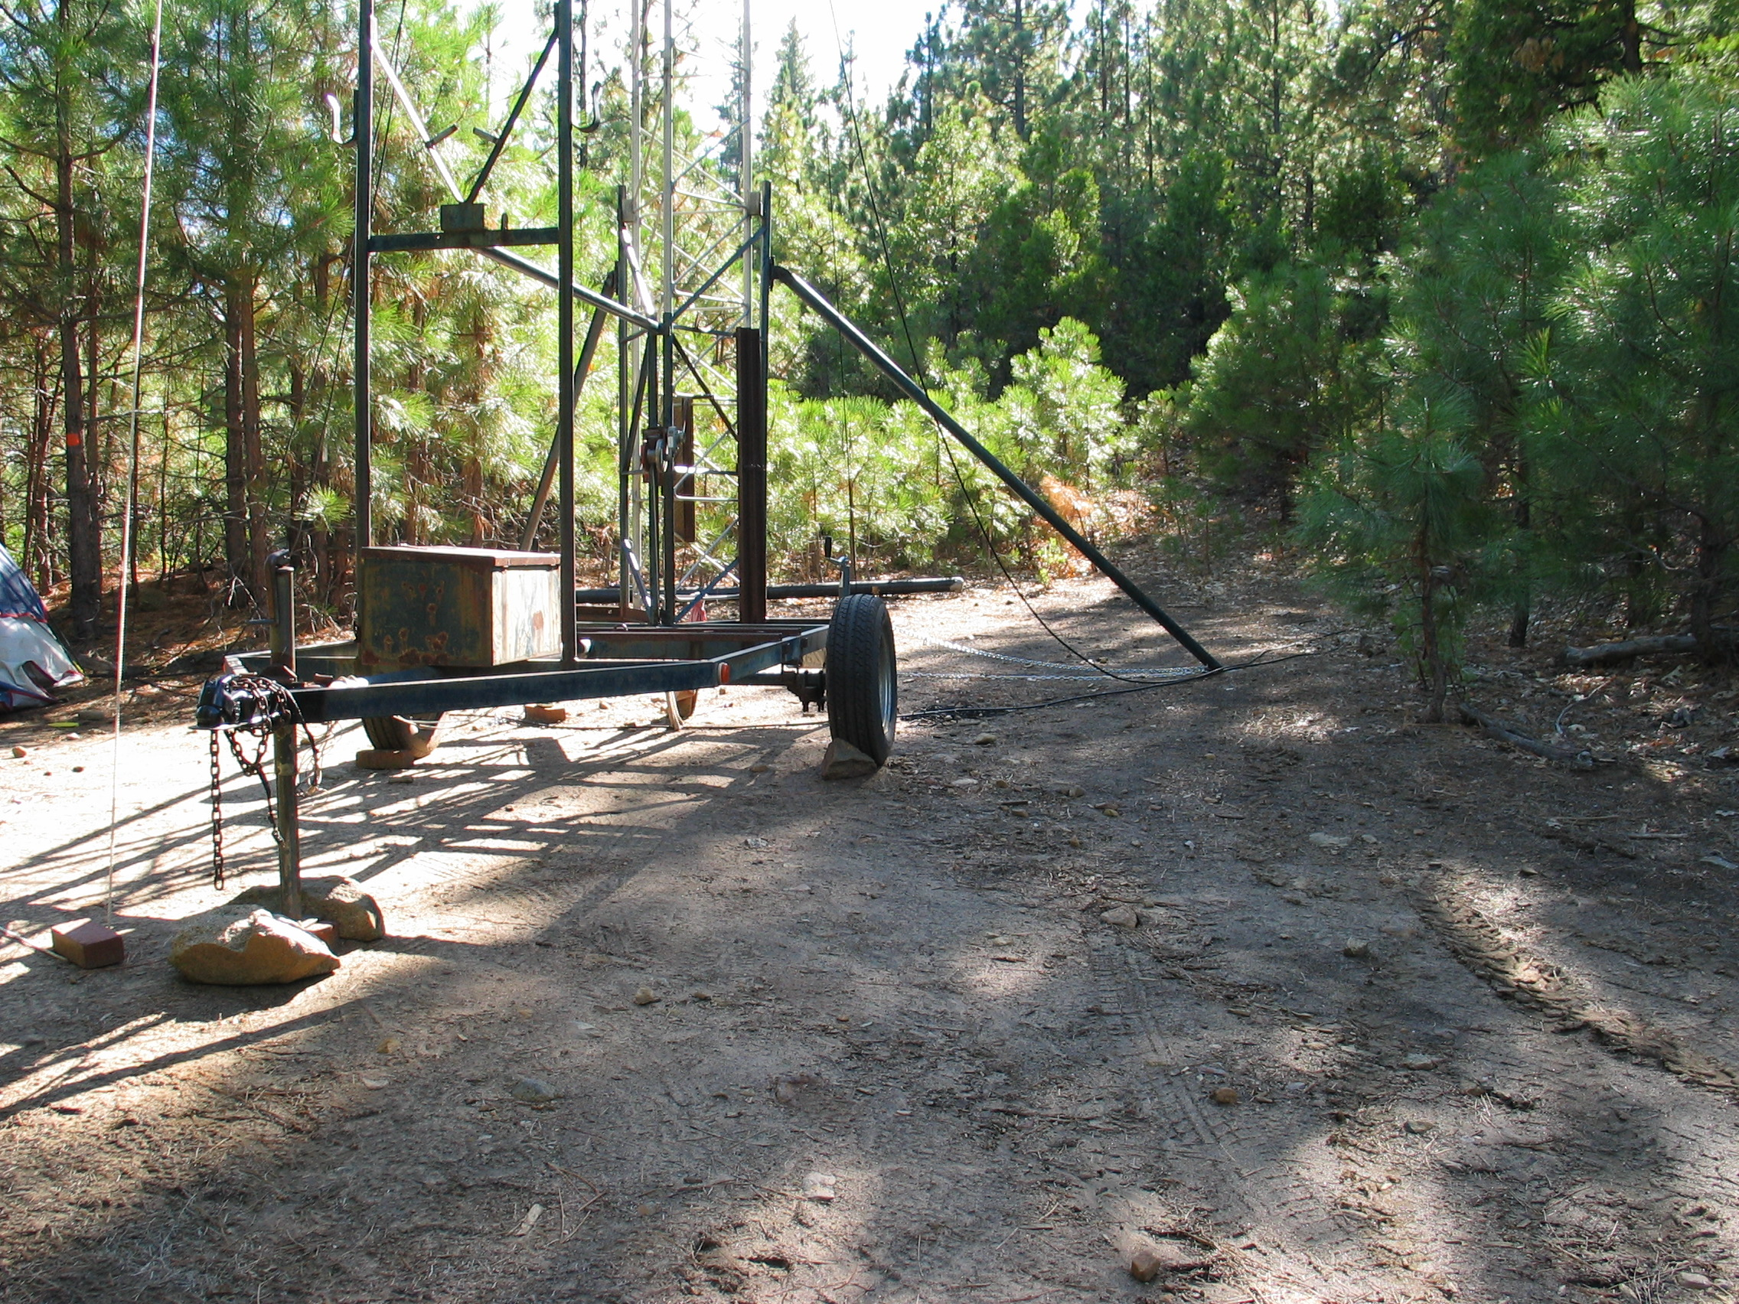
What is the WVARA Tower Trailer?
Single axle
3-section aluminum crank-up tower (~40’)
Brake winch
Rotator
Rear outrigger legs
Leveling jacks
Storage box near tongue
Hitch for 2” ball
4-way flat connector for tail lights
Steel mast (~10’)

Slide 3
Outline
Where I have taken the trailer
State of the trailer
Optimizing performance with the tower

Slide 4
A. WHERE I HAVE TAKEN THE TRAILER

Slide 5
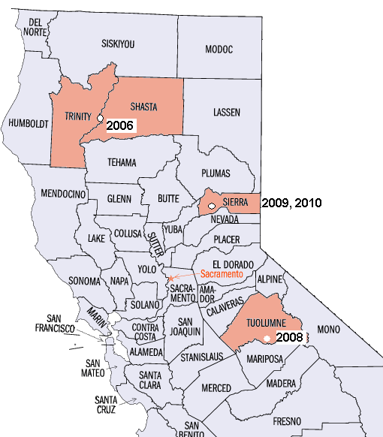
Where I Have Taken the Trailer: 2006-2010
California QSO Party
http://www.cqp.org
First full weekend in October
Goal is for all 58 CA counties to be active and contact the world
I like to help activate rare counties by going on a “county expedition”

Slide 6
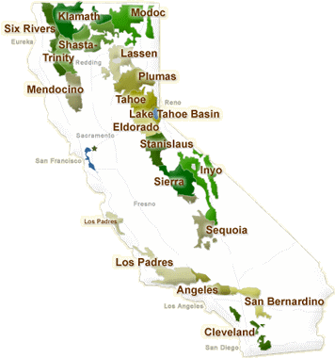
Where Exactly Do I Go?
USFS land (U.S. Forest Service)
18 National Forests
20 Million acres
BLM Land (Bureau of Land Management)
15.2 million acres
Land in 55 of 58 CA Counties
“Dispersed camping”
Use Google Earth & topo maps to look for ridge tops downsloping to the east
USFS National Forests

Slide 7
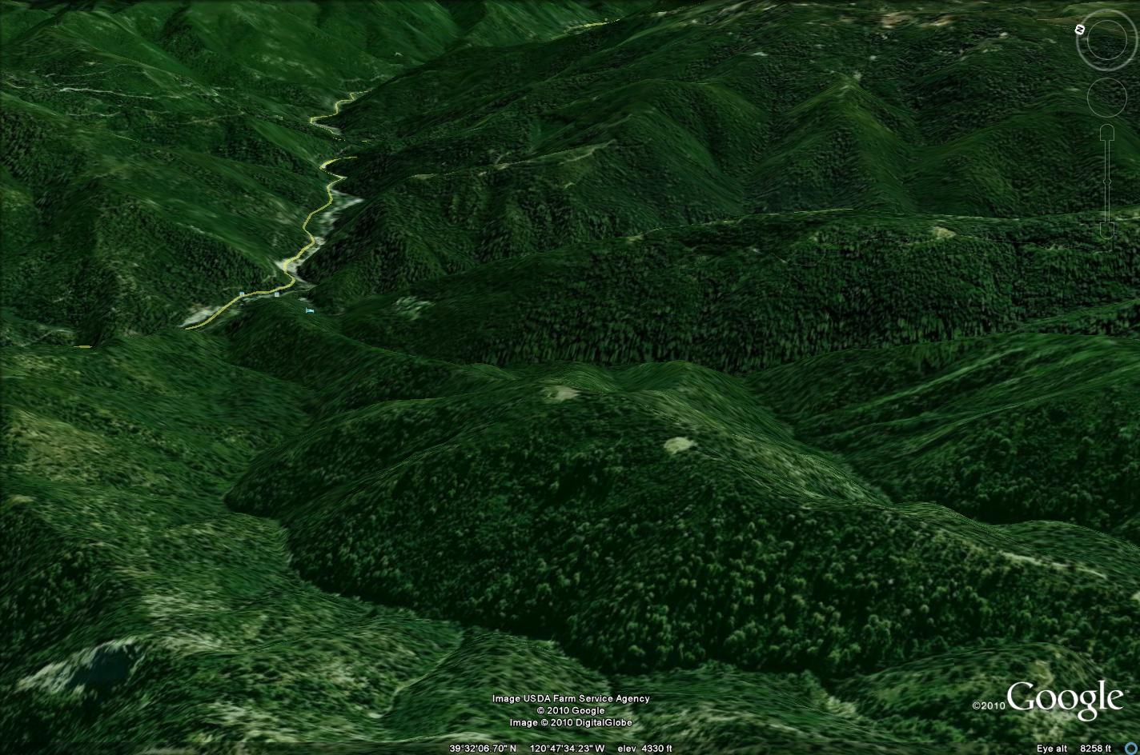
Sierra

Slide 8
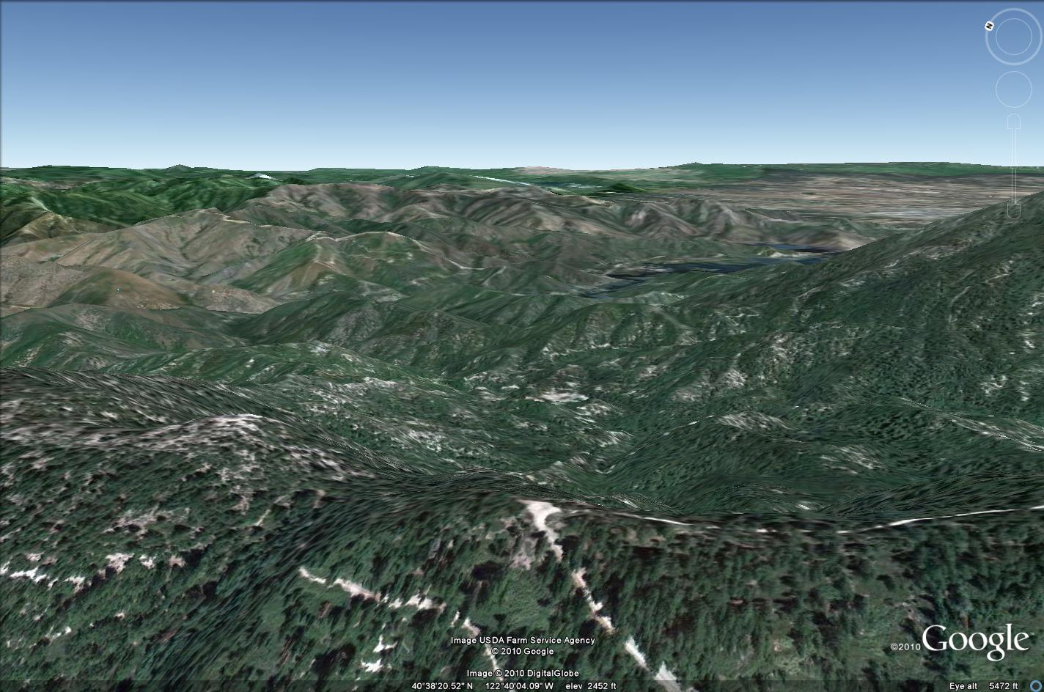
Trinity/Shasta

Slide 9
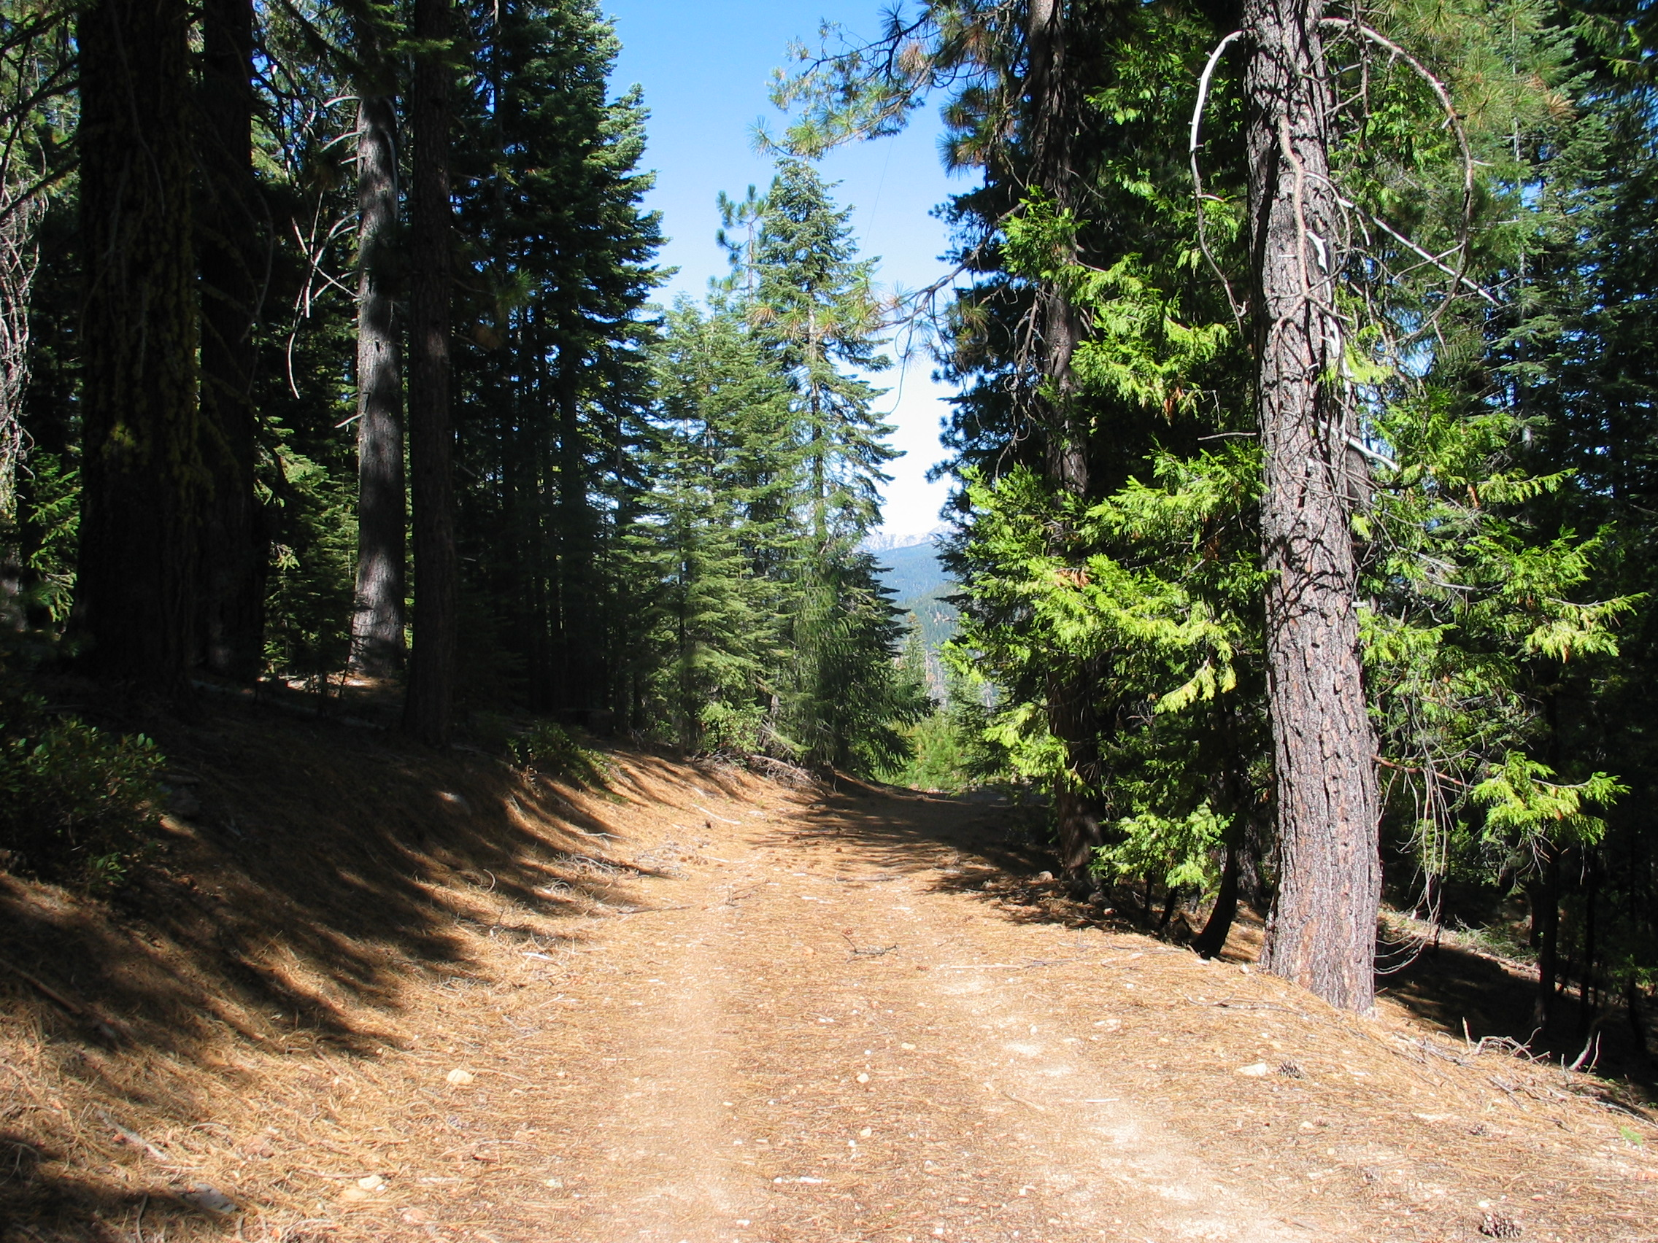
Roads
Aren’t trips to ridge tops hard on the trailer? Well, no.
Always go on scouting trip.
Look for short, easy dirt roads
Trinity/Shasta, Sierra: 2 miles
Tuolumne: 4 miles
4x4 not needed

Slide 10
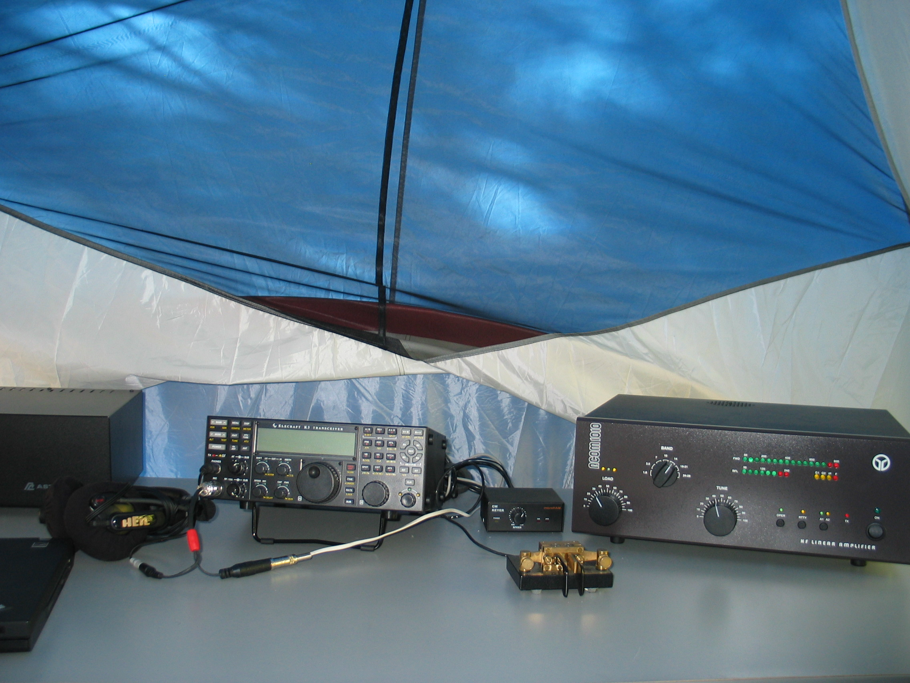
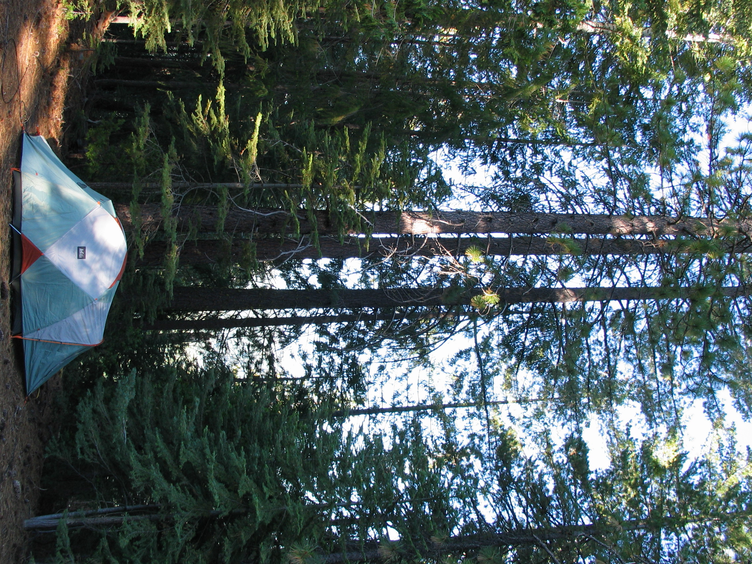
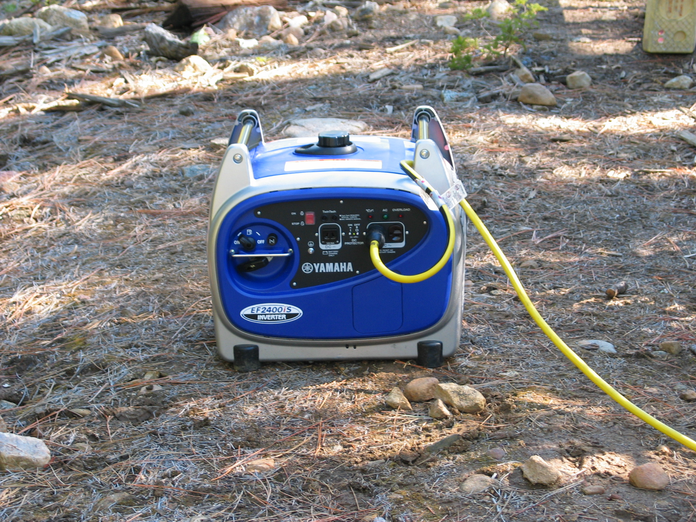
Expedition Category

Slide 11
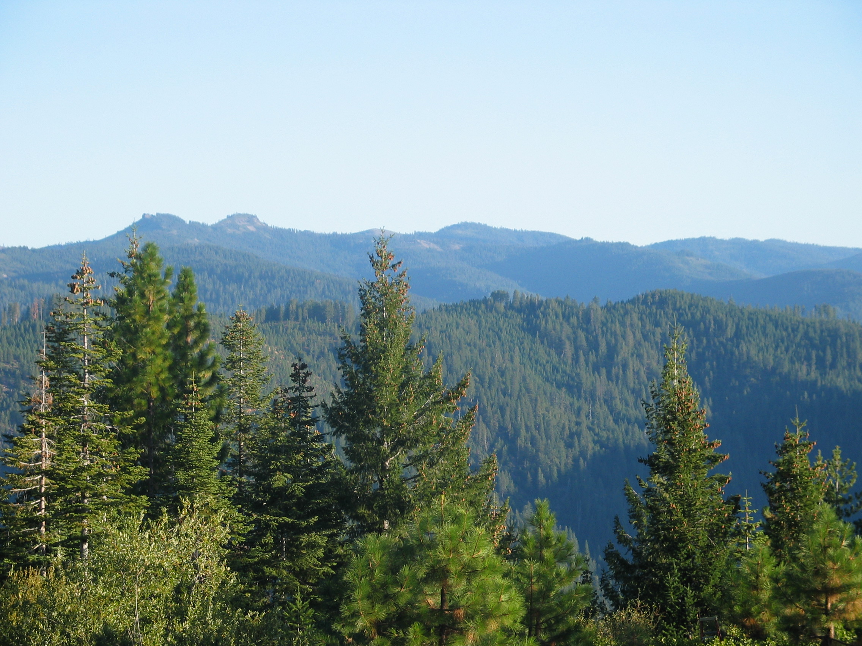
Why?
Camping in beautiful CA forest + ham radio
Operate from a site unlike at home
Quiet
Downsloping terrain
Tall trees
No neighbors
More space
CQP expedition how-to: http://cqp.org/Videos.html

Slide 12
B. STATE OF THE TRAILER

Slide 13
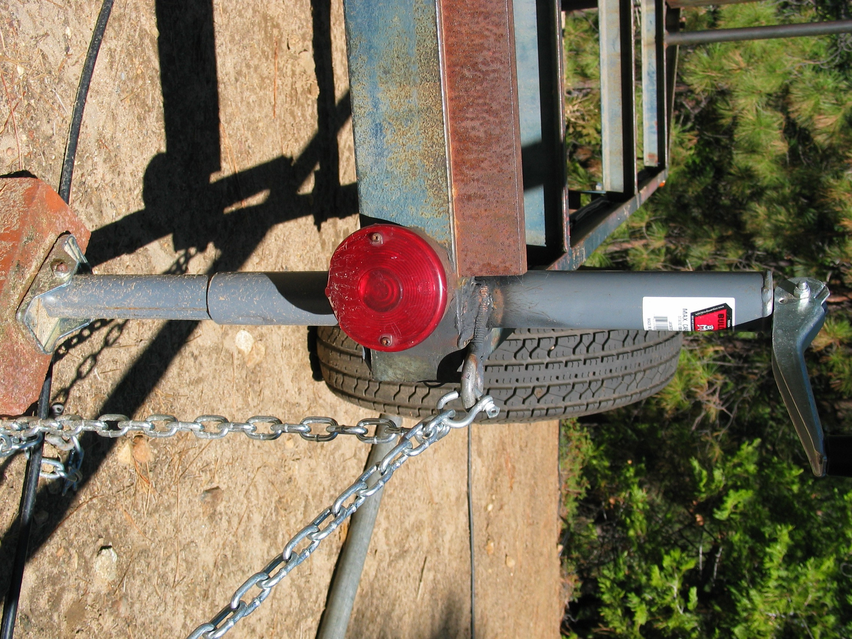
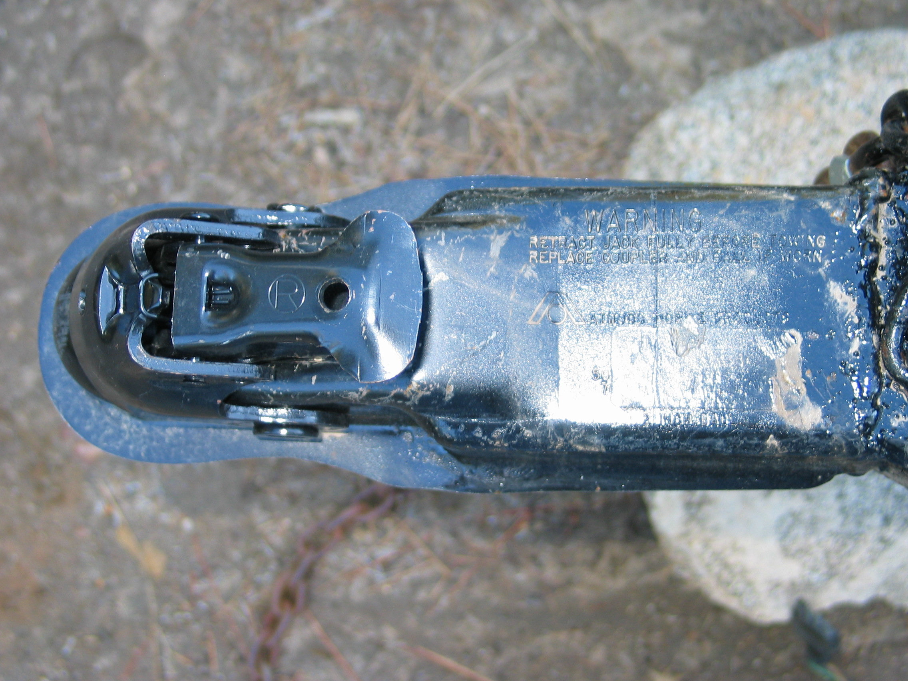
State of the Tower Trailer
Probably the best I’ve seen it
Recent improvements:
2008: New trailer hitch, rear jacks, chain: KF6EMB

Slide 14
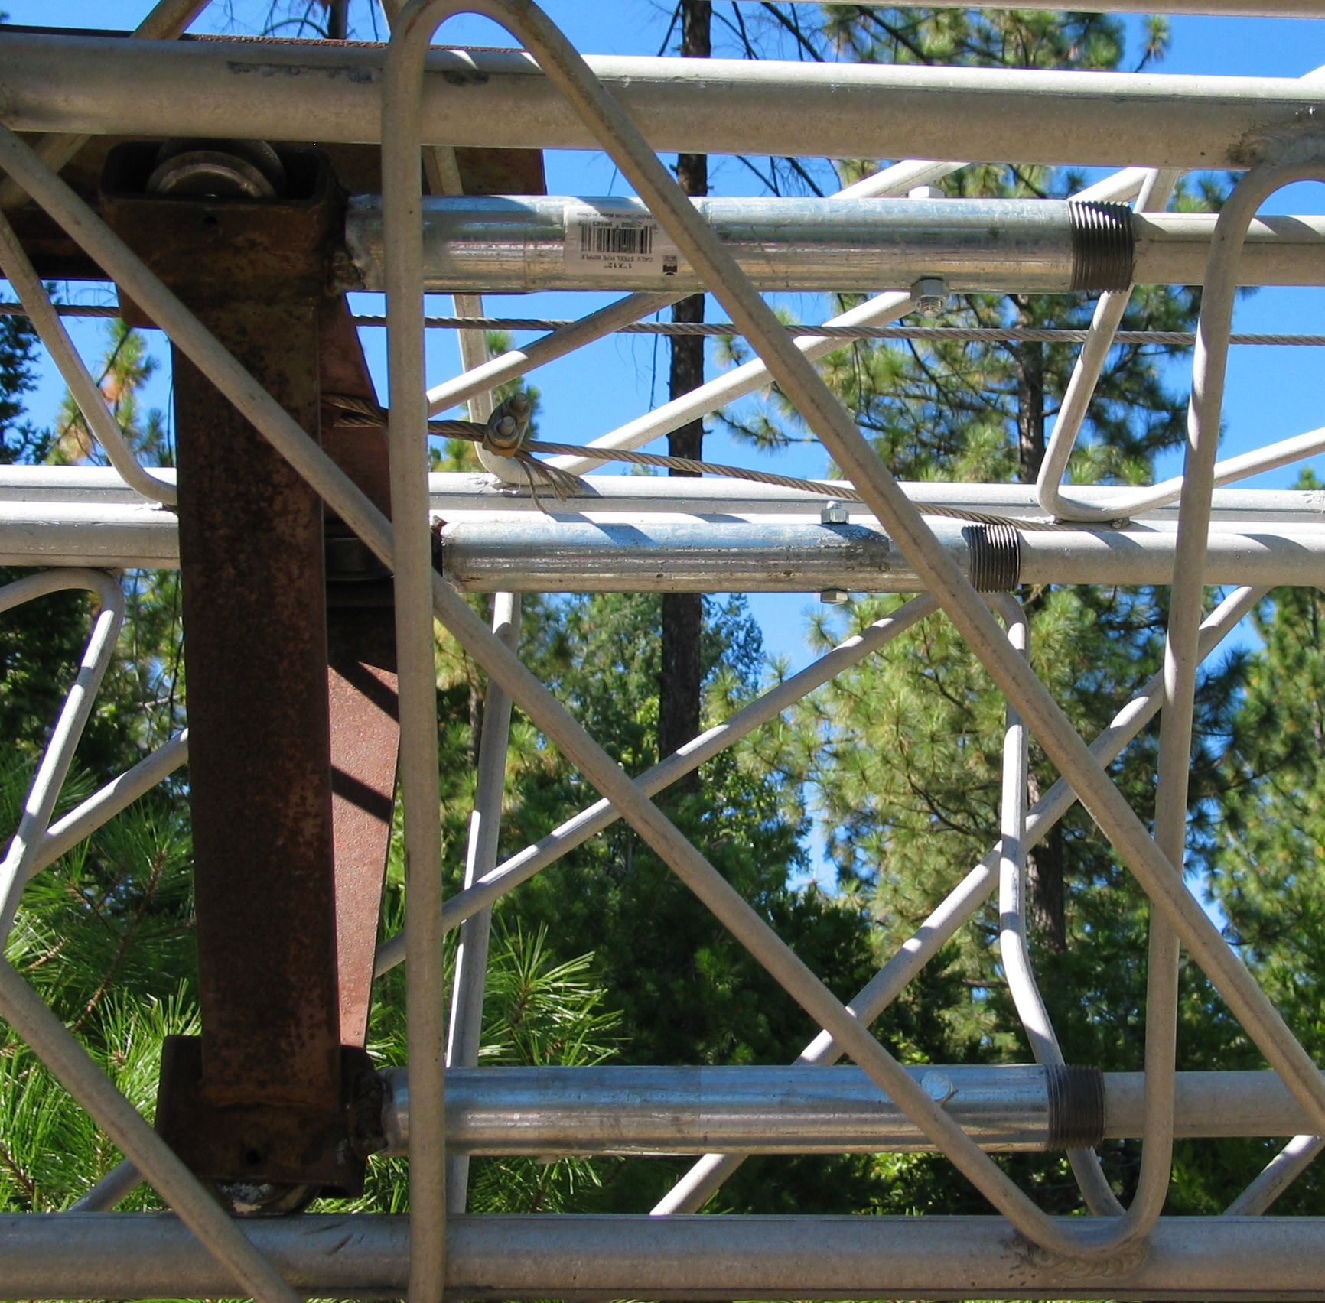
State of the Tower Trailer
Improvements:
2007 – new tires (WVARA)
2008 – major repair to tower (KF6EMB)
2009 – fixed slow leak in tire valve stem (N6DE)
2009 – new wheels (N6DE)
2010 – new wheel bearings (N6DE)

Slide 15
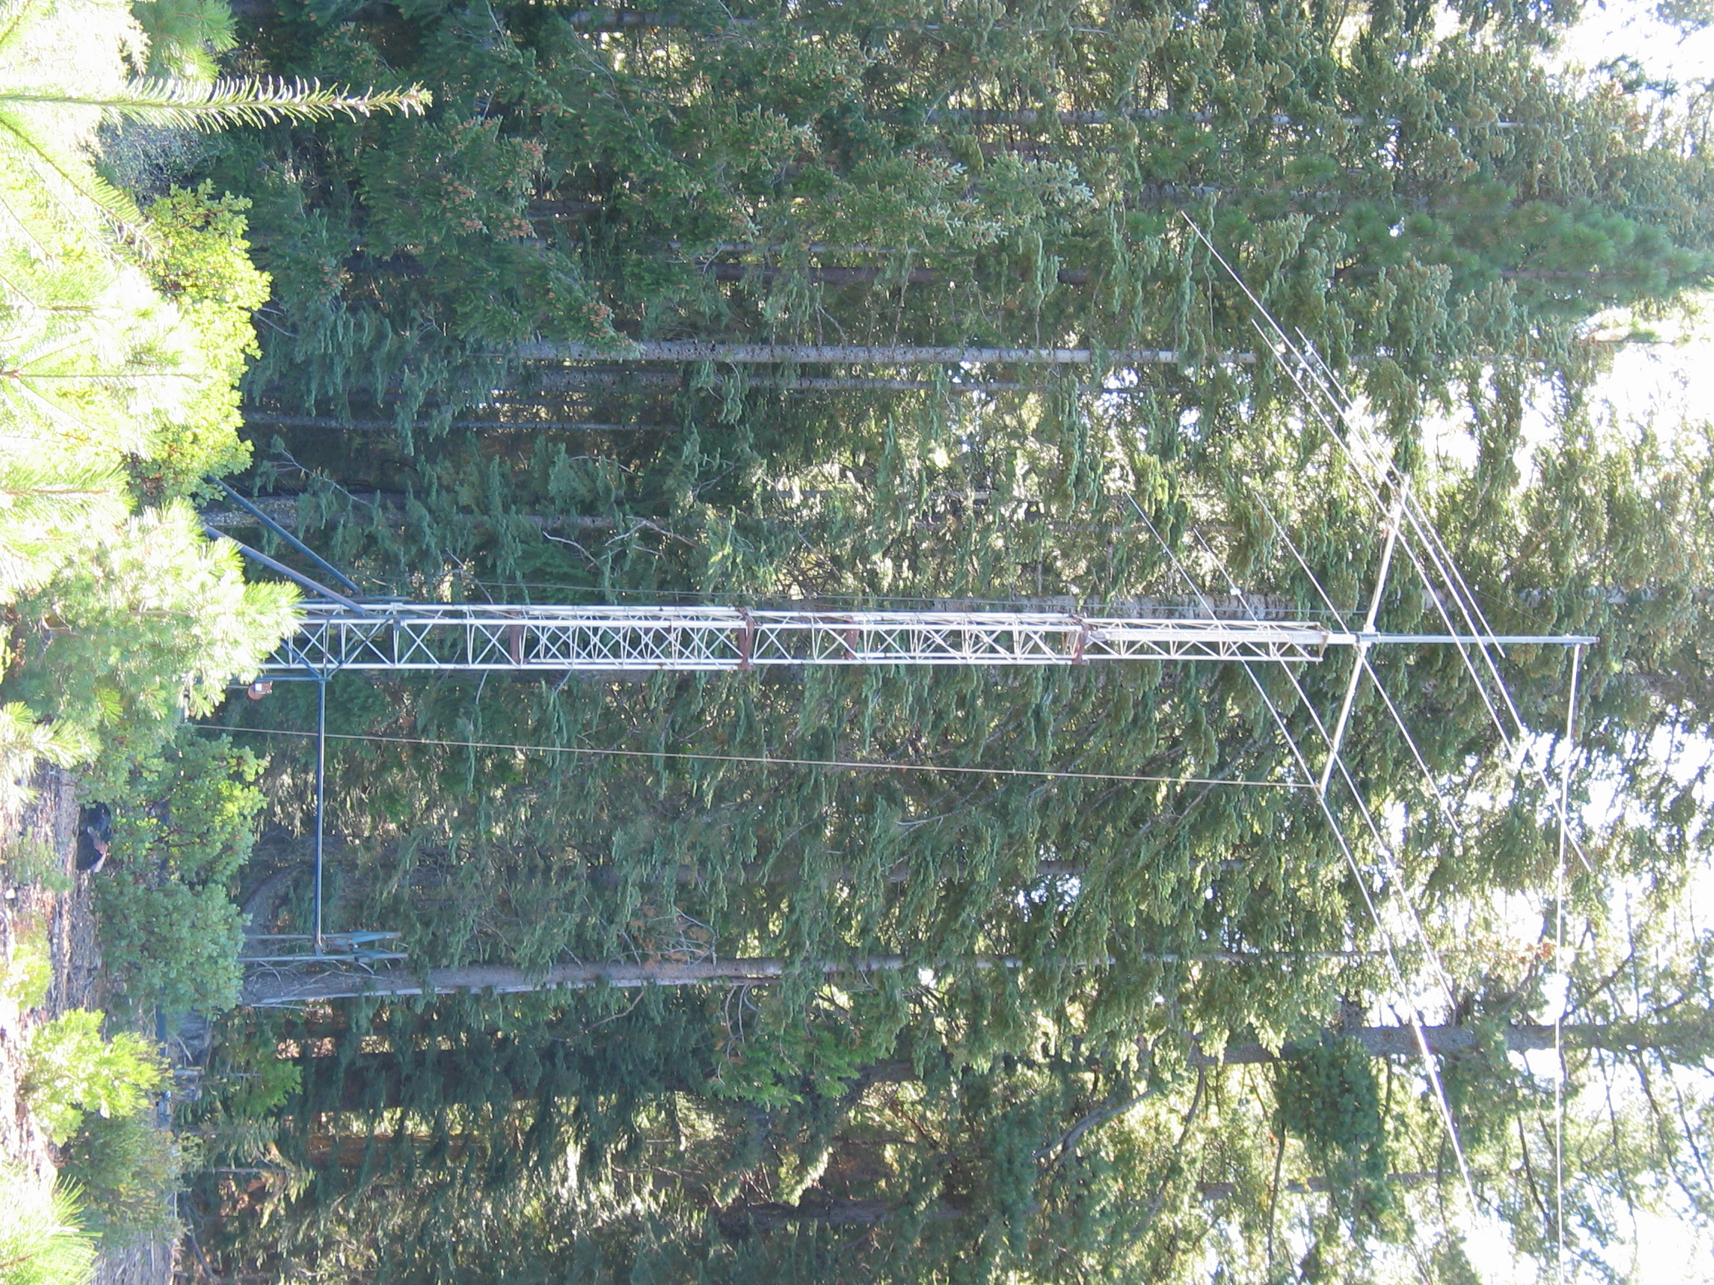
State of the Tower Trailer
Misc. Improvements:
Each year – Box supplies
Level (N6DE)
Bungees (N6DE)
Tie-downs (WVARA, KK6VF)
Pulleys, eye bolts, carabiners (N6DE)
Bolts, screws, WD40
2010 – new red mesh towing flag (N6DE), replaced rusted screws on tail lights
Other 2010 Additions:
AB-577 (KZ2V and other WVARA members)
Mast for AB-577 (N6DE)
Getting the AB-577 was a good move. Congrats to the WVARA members who made this happen.

Slide 16
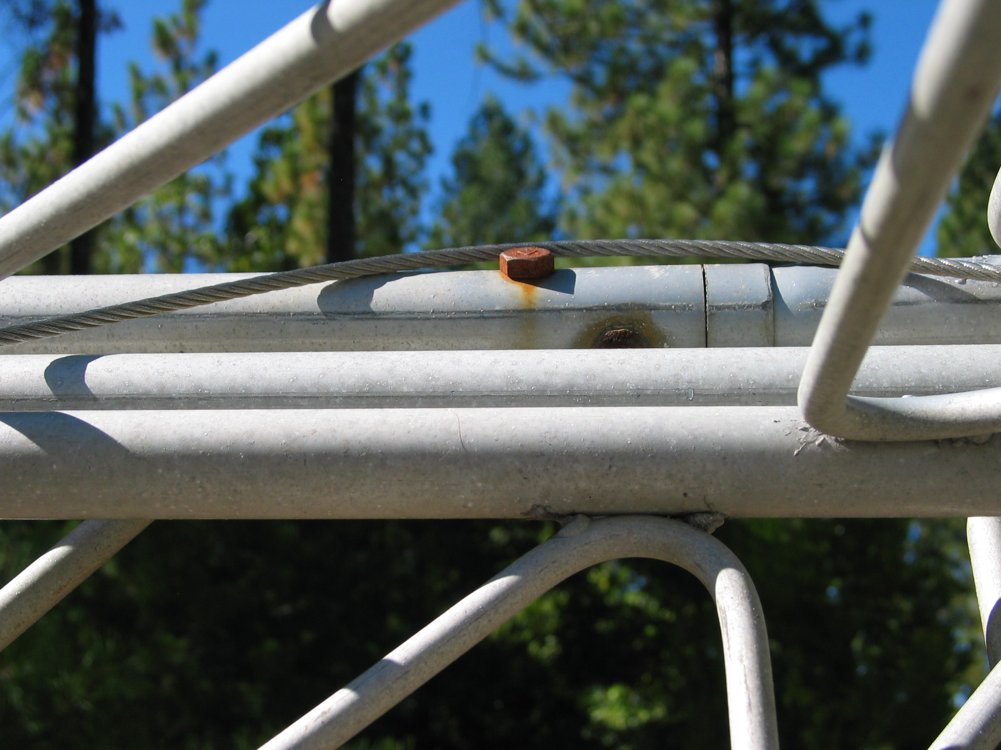
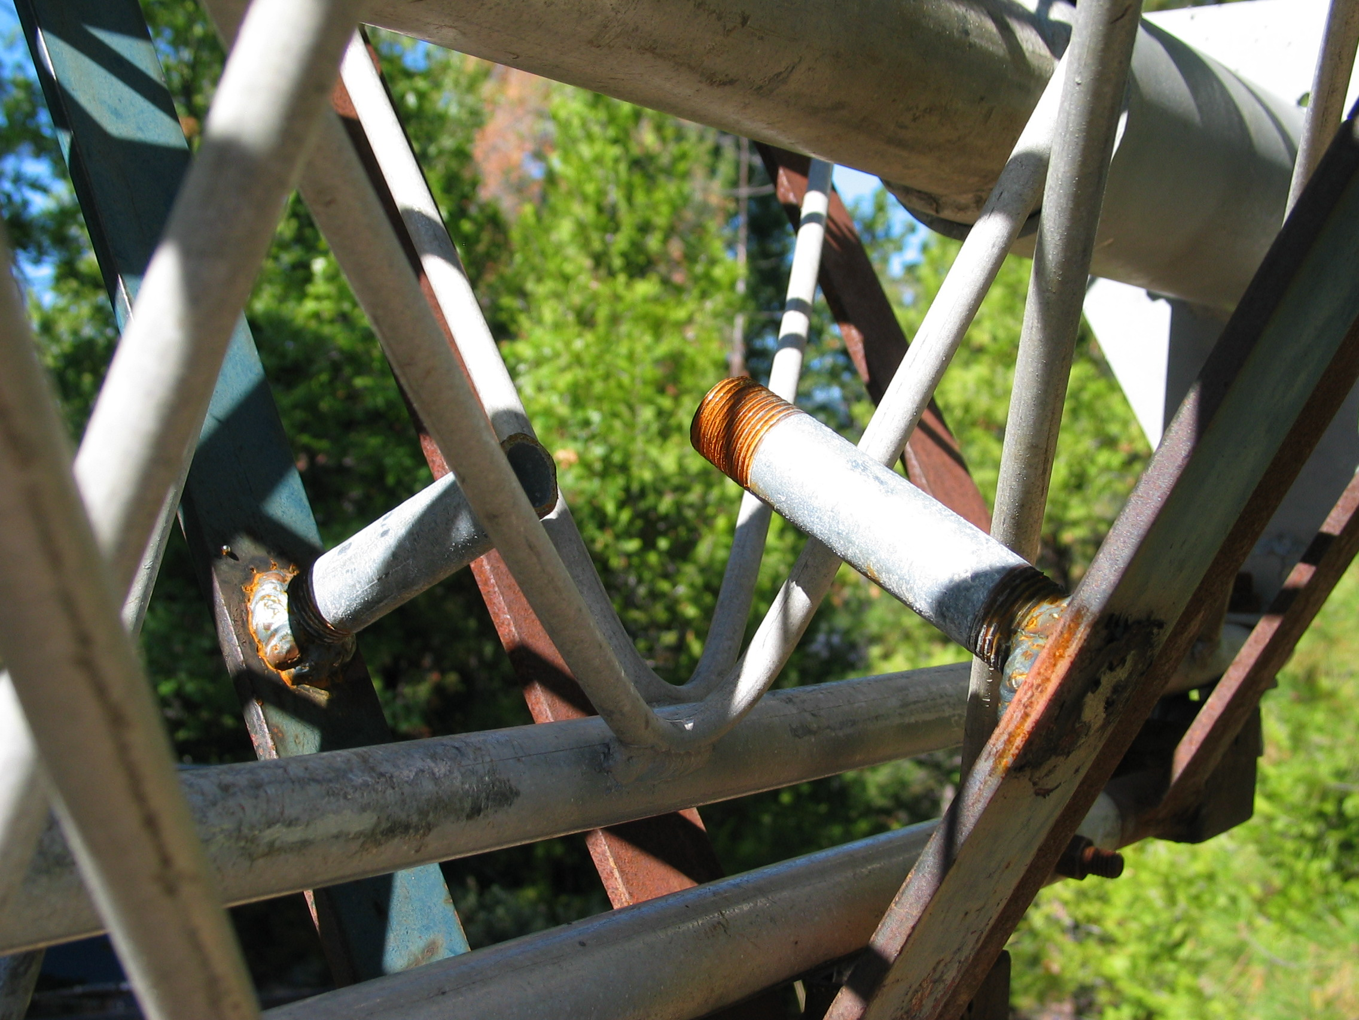
State of the Tower Trailer
Observations:
WVARA officers have been very smart to use the tower trailer more than once a year.
Thanks to KK6VF for storing the tower trailer, protected from the weather.
Know what you are doing when raising and lowering the tower.
Future potential improvements:
Rotor work
Cable
Rusted supports & hardware

Slide 17
C. OPTIMIZING PERFORMANCE WITH THE TOWER

Slide 18
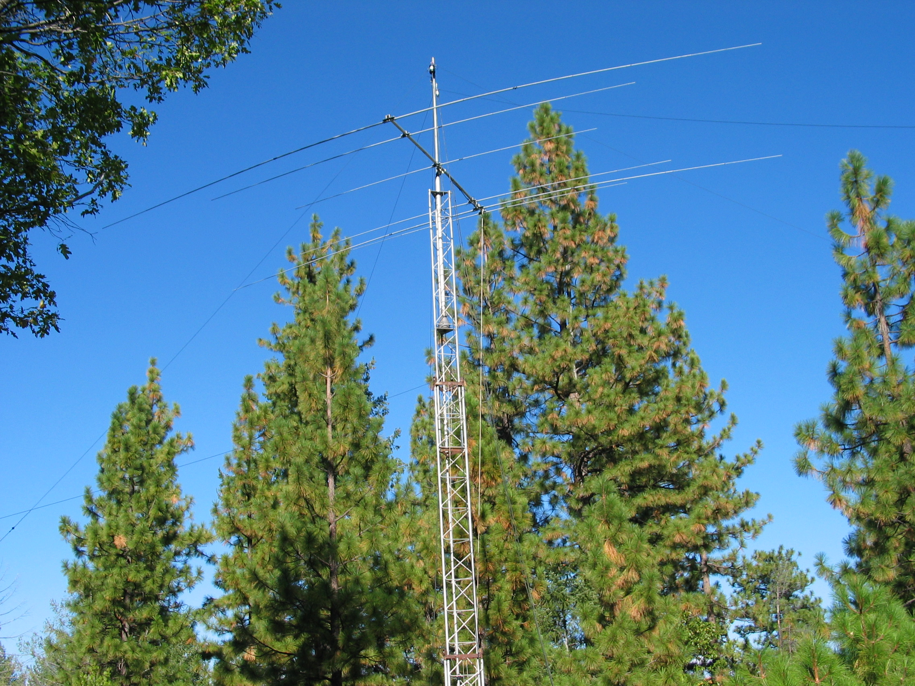
Antennas
2006,2008,2009:
Force12 C3S
(10/15/20 tribander on 12’ boom)
Inv-Vees on 40m & 80m

Slide 19
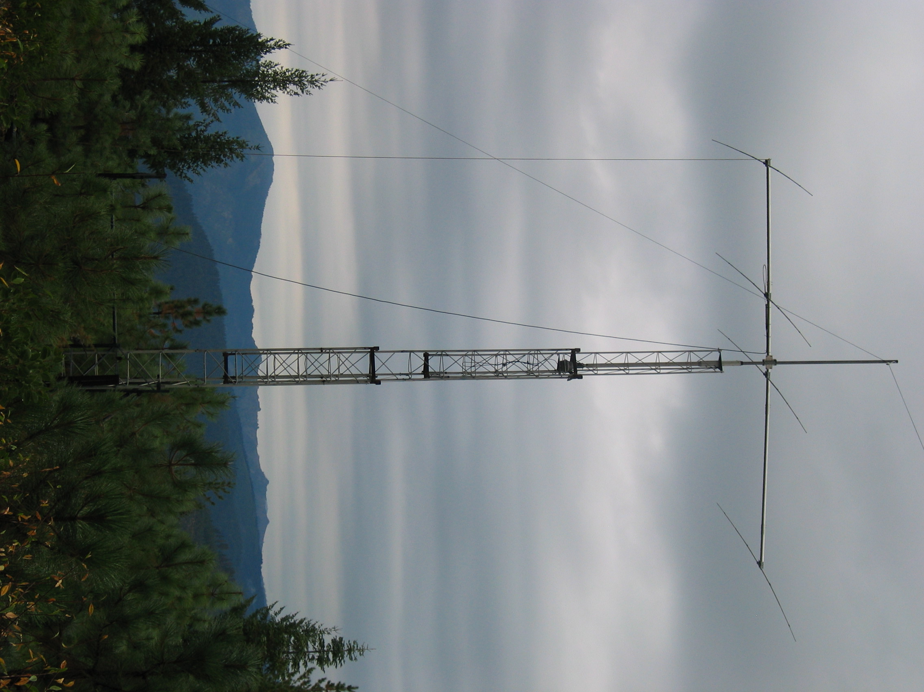
Antennas
2010:
Force12 EF415 (4-el 15m Yagi on 20’ boom; 26 pounds)
Pulley at top of mast to support one end of a homebrew 20m antenna
Wires in trees

Slide 20
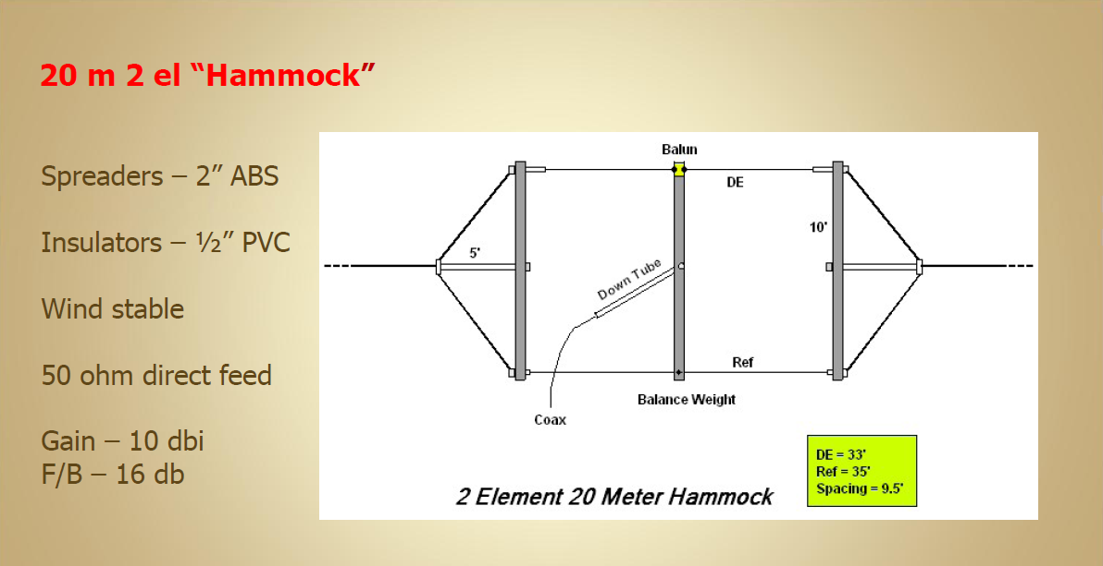
Antennas
KF6T Design

Slide 21
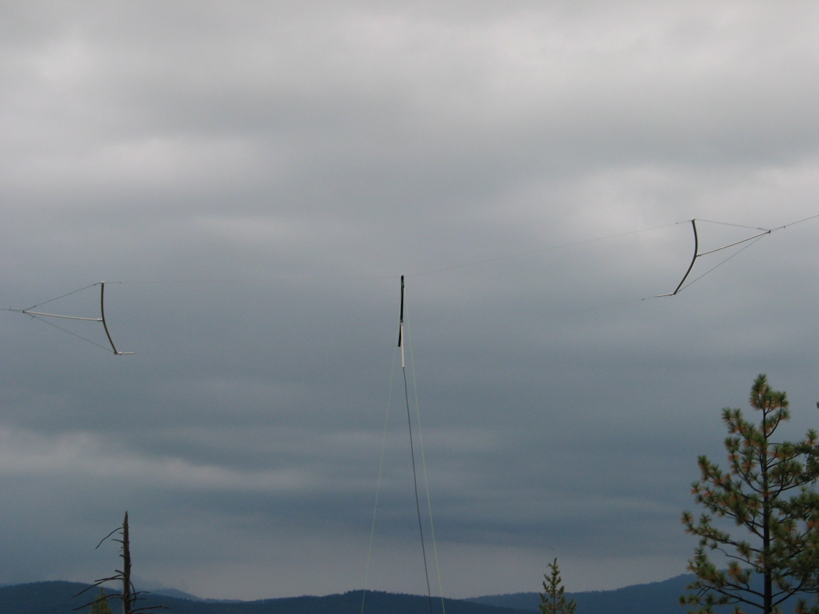
Antennas

Slide 22
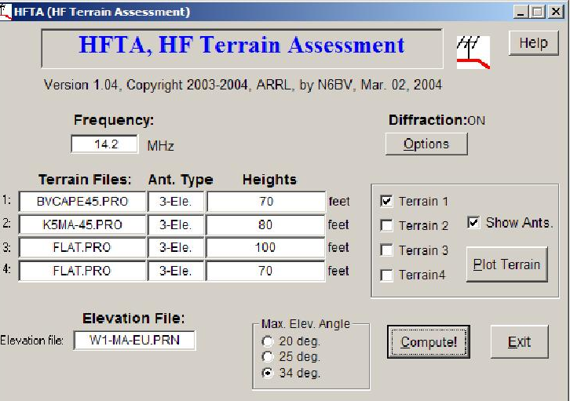
Terrain
Q: How high should I crank up the tower?
A: Simulate using HFTA.
HFTA (High Frequency Terrain Assessment) is a program by N6BV from the ARRL Antenna Book.
Analyzes elevation angles from user generated terrain data.
How-to video: http://www.nccc.cc/misc/HFTA.wmv

Slide 23
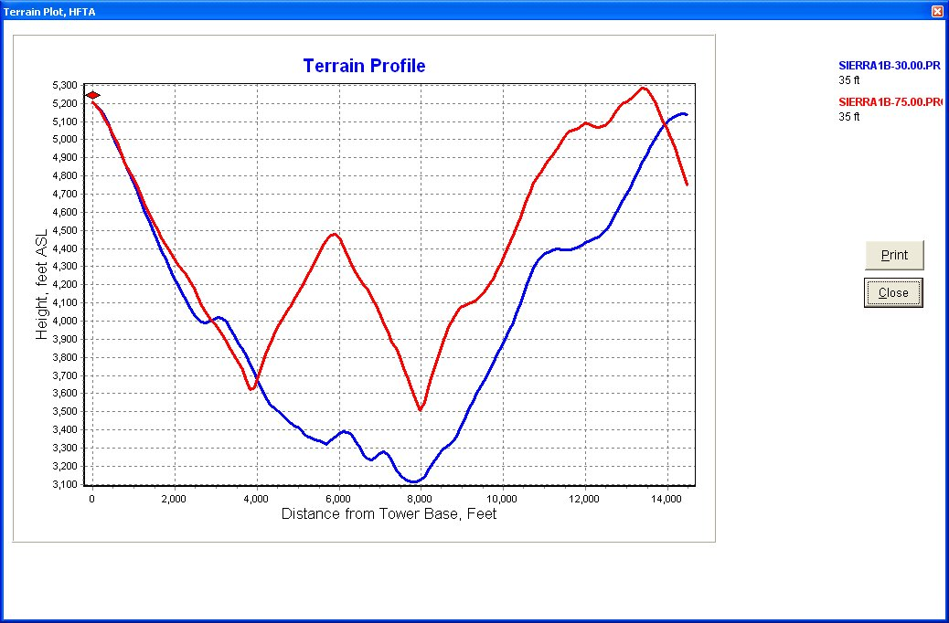
Terrain

Slide 24
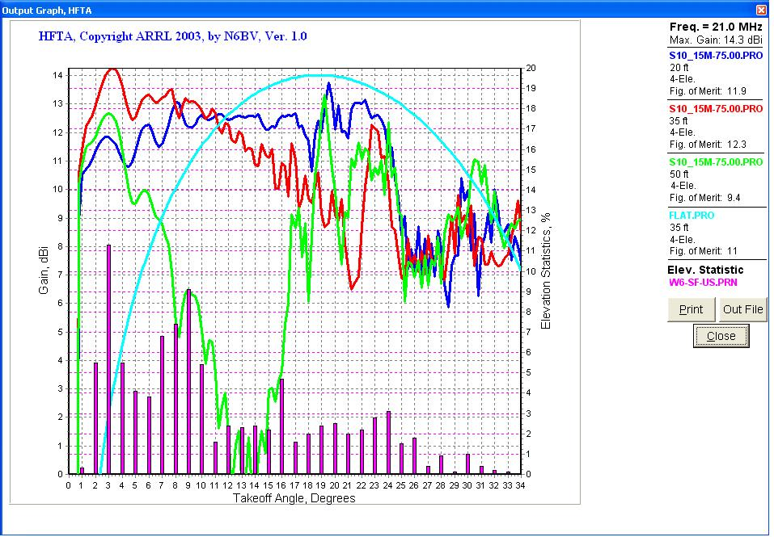
15m to U.S.
US = Boston,
Chicago, Dallas,
Detroit, Miami, SF,
Seattle, Wash_DC

Slide 25
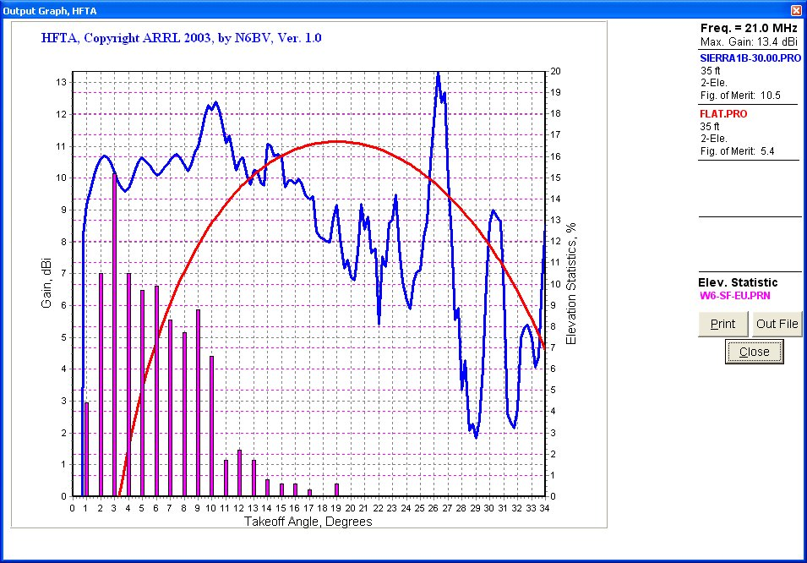
15m to Europe

Slide 26
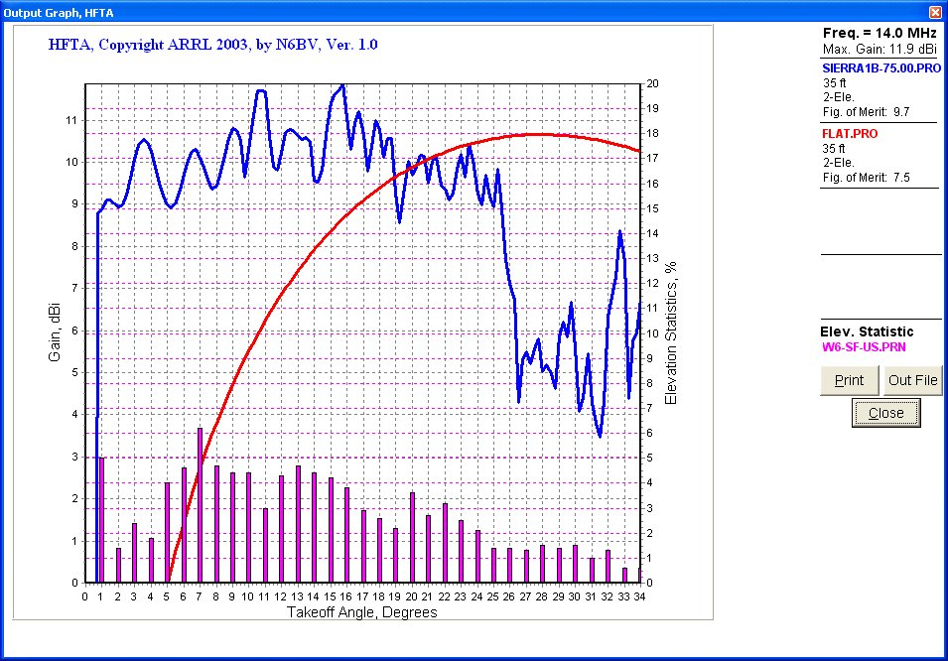
20m to U.S.

Slide 27
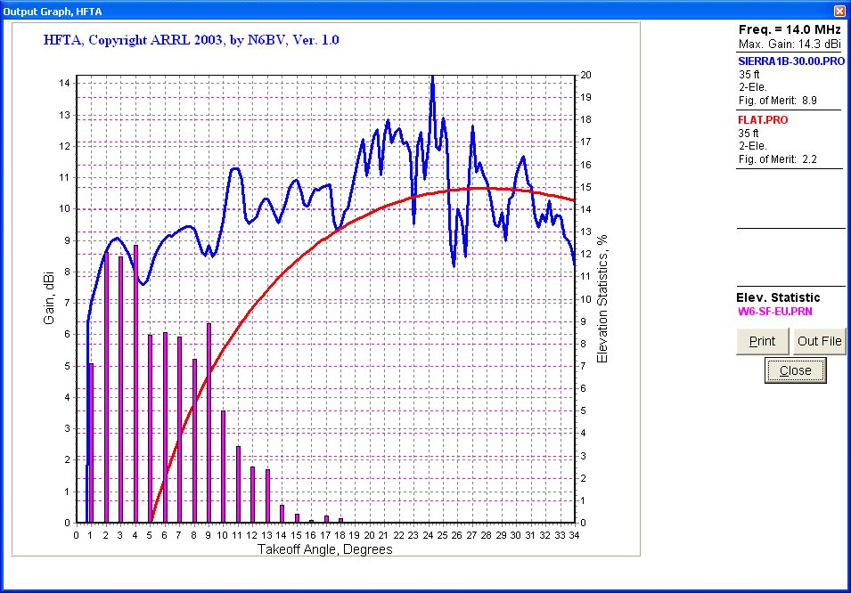
20m to Europe

Slide 28
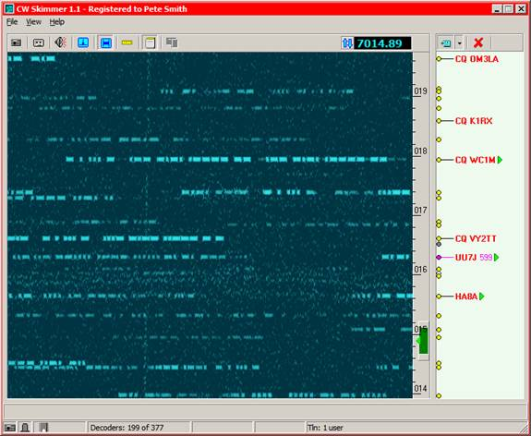
Reverse Beacon Network
Q: How was my signal in the contest?
A: Analyze Reverse Beacon Network (RBN) spots.
CW Skimmer (by VE3NEA) with SDR will decode CW stations calling CQ.
Displays call, freq, SNR, time, and speed
RBN is a network of stations running Skimmer.

Slide 29
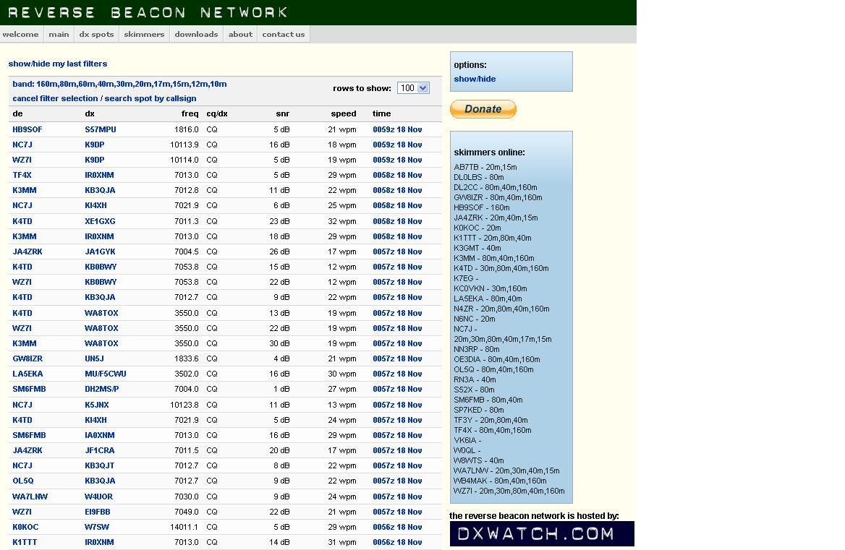
reversebeacon.net

Slide 31
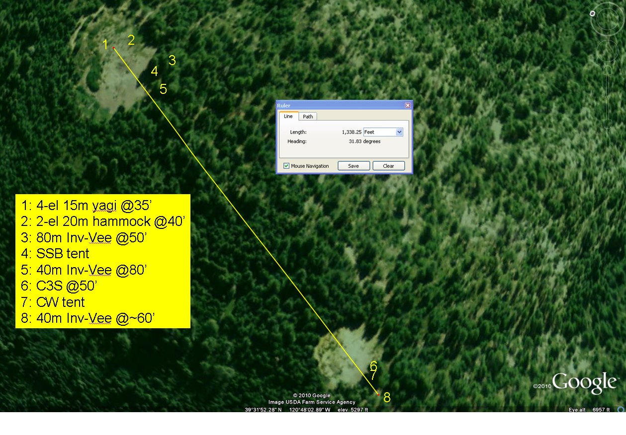
2010 Layout: CW & SSB at High Power
Keys:
Antenna separation
Low phase noise TX
See NCJ 2 part article by KC9CHG and N9TO on Field Day Interference Mitigation.

Slide 32
N6DE CQP Results: 2006-2010
 | 2006 | 2008 | 2009 | 2010
Power | 100W | 600W | 600W | 600W
Category | Single-Op | Single-Op | Single-Op | Multi-Multi (+N6CCH, N6RC, N6TU)
Total QSOs | 1,509 | 1,542 | 2,071 | 2,432
Accolades | 2nd Exped 2nd LP | 1st Exped 16th Overall New TUOL record | 1st Exped 11th Overall New SIER record New all time Exped record | ? Excellent 15m SSB numbers 15m packet spots from EU

Slide 33
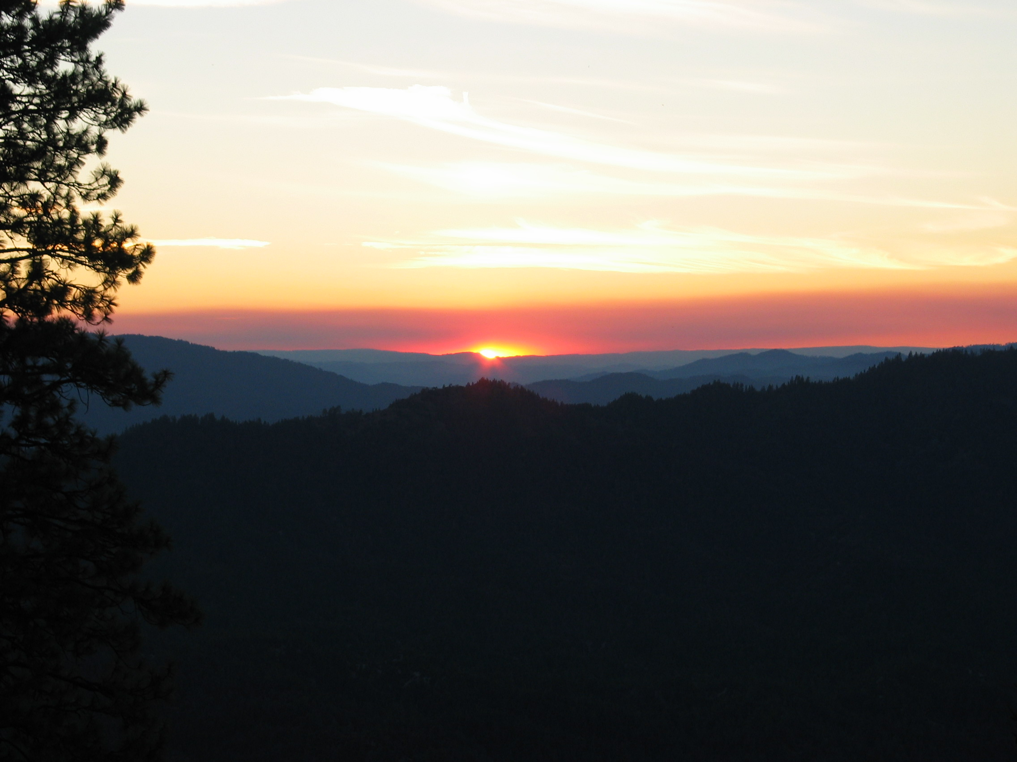
Thanks to WVARA for the use of the tower trailer!

